Slide 1


Slide 2




Silicon Wafer Defects
Classification Using Deep Learning
Techniques
Harnessing the Power of Deep Learning for Precise Silicon Wafer Defect Analysis
Researcher
Supervisor
Hussein Younis
Master's student
Amjad Rattrout
Associate Professor
Arab American University, Palestine
Arab American University, Palestine

Slide 3
Table of Contents
Introduction.
Silicon Wafer Map Analysis.
Research Problem and Questions.
Aims and Objectives of the Study.
Overview of Relevant Literature.
Gaps In the Literature.
The Proposed Methodology.
Findings and Discussions.
DefectClassifierX application.
Research Contributions.
Limitations.
Conclusion.

Slide 4
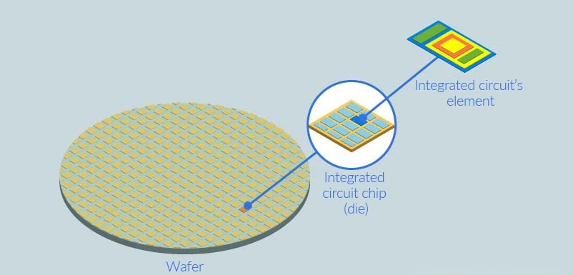
Introduction
The inside of a tiny semiconductor chip is packed with thousands to millions of electronic components (diodes, transistors, capacitors, resistors).
Notes:
رقاقة السيليكون هي شريحة رقيقة من السيليكون البلوري تعمل كركيزة لبناء دوائر متكاملة (ICs). الدوائر المتكاملة، من ناحية أخرى، هي أجهزة إلكترونية صغيرة تتكون من العديد من المكونات الإلكترونية المترابطة مثل الترانزستورات والمقاومات والمكثفات المصنعة على رقاقة السيليكون. في الأساس، رقاقة السيليكون هي المادة الأساسية التي يتم إنشاء الدوائر المتكاملة عليها من خلال سلسلة من...
An integrated circuit (IC) is a small electronic device made up of multiple interconnected components such as transistors, resistors, and capacitors on a single semiconductor wafer. These components work together to perform various functions in electronic devices like computers, smartphones, and televisions.
Now, let's talk about wafer defects. Wafer defects are imperfections or abnormalities that can occur during the manufacturing process of semiconductor wafers. These defects can impact the performance and reliability of integrated circuits that are produced from these wafers. Common types of wafer defects include particles, scratches, contamination, and pattern defects.
It is crucial for manufacturers to detect and address wafer defects early in the production process to ensure the quality and functionality of the integrated circuits that are ultimately created from these wafers. Various inspection and testing techniques are employed to identify and mitigate wafer defects before they result in faulty ICs.

Slide 5

Fortune Business Insights statistics
Indicates that the global consumer electronics market is expected to see substantial growth reaching
989.37 billion USD
by 2027

Slide 6
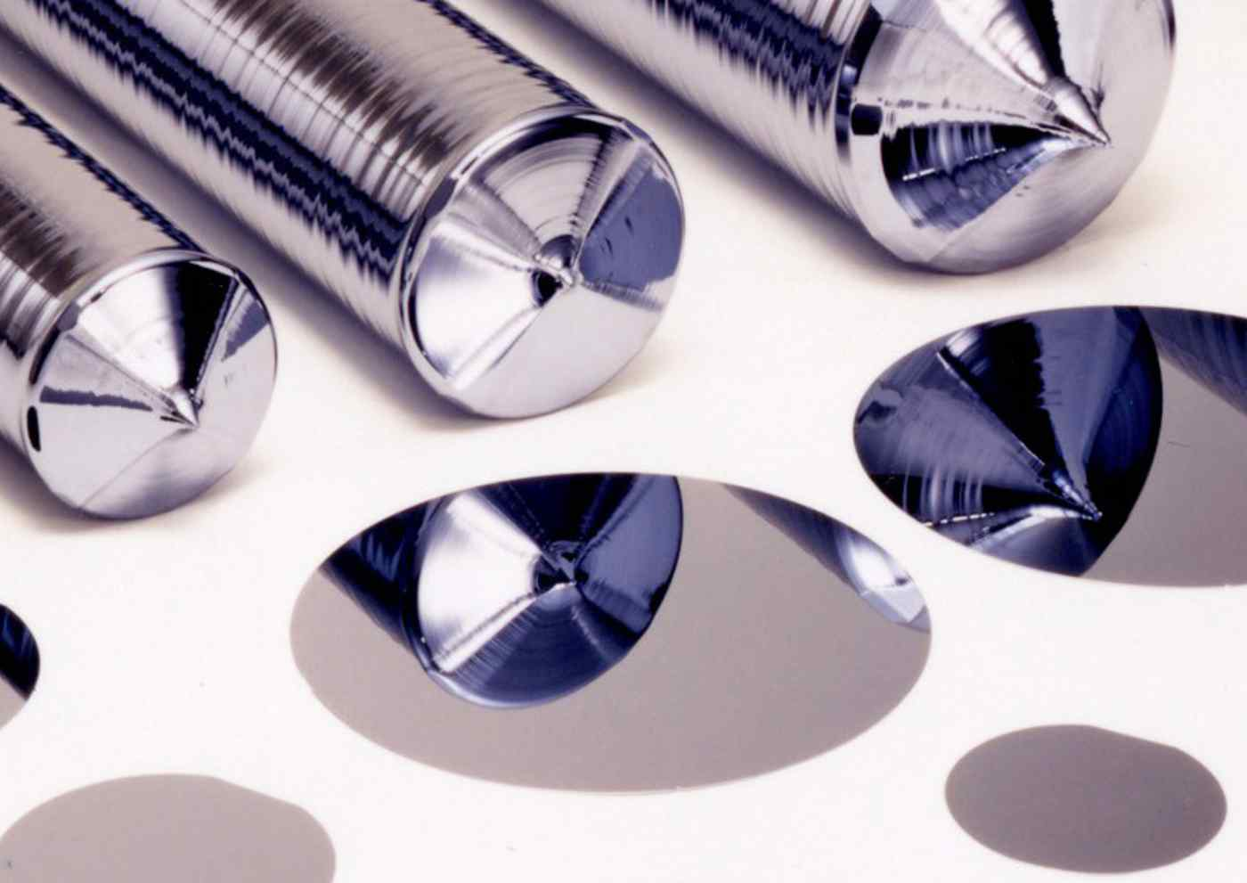
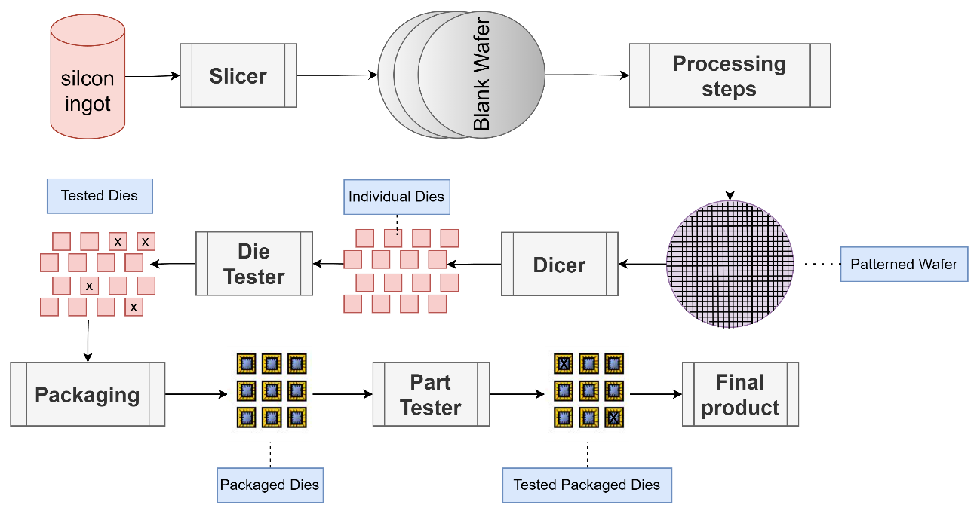
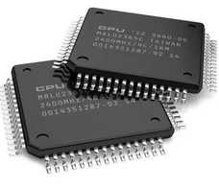
Integrated Circuits Manufacturing
01
03
02
silicon ingots
Final product
Integrated Circuits Manufacturing

Slide 7
Challenges in Defect Classification
1
Manual inspection is time-consuming and subjective.
It can also be prone to errors due to human limitations.
2
Traditional methods for defect classification rely on manual inspection.
Experts visually examine the wafers and categorize defects based on their knowledge and experience.
3
Manual inspection is time-consuming and subjective.
It can also be prone to errors due to human limitations.

Slide 8
Traditional Methods for Defect Classification
Semiconductor manufacturing process takes up to
26.
weeks
Training process for engineers to manually classify defects with an
9.
90%
accuracy of
takes up to
months

Slide 9
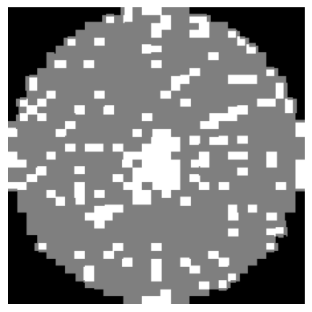
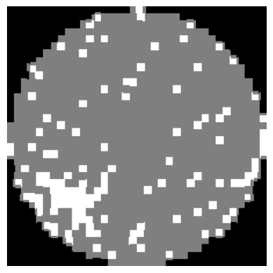
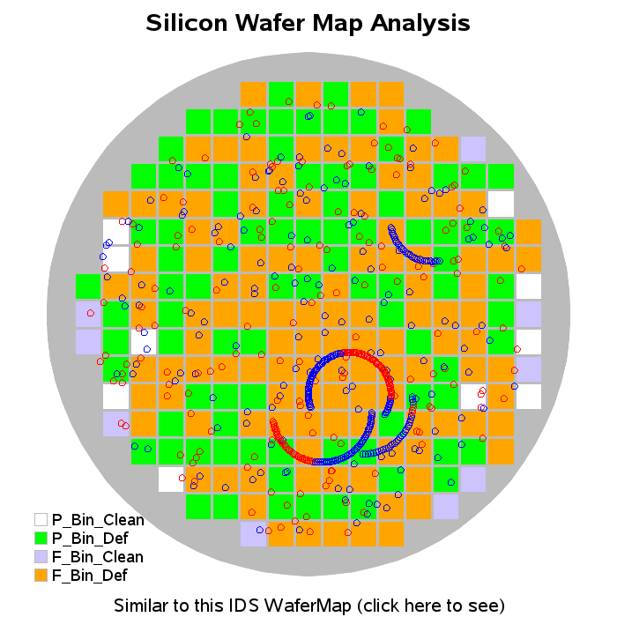

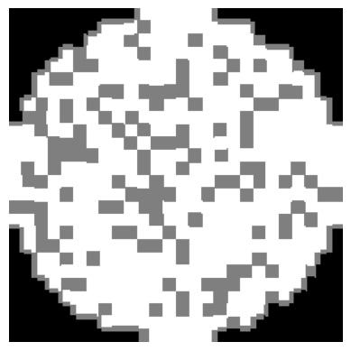
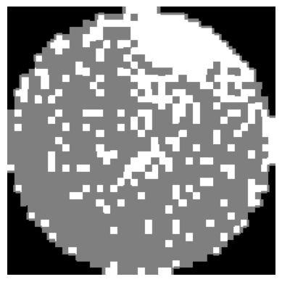
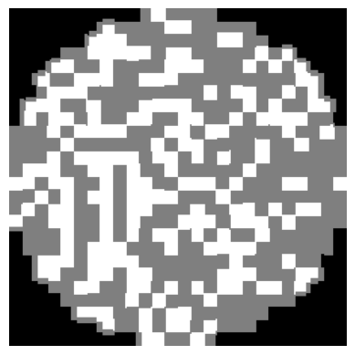
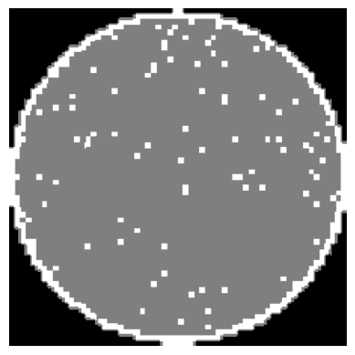
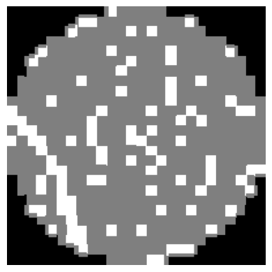
Silicon Wafer Map Analysis
Center
Loc
Donut
Near-Full
Edge-Loc
Random
Edge-Ring
Scratch

Slide 10
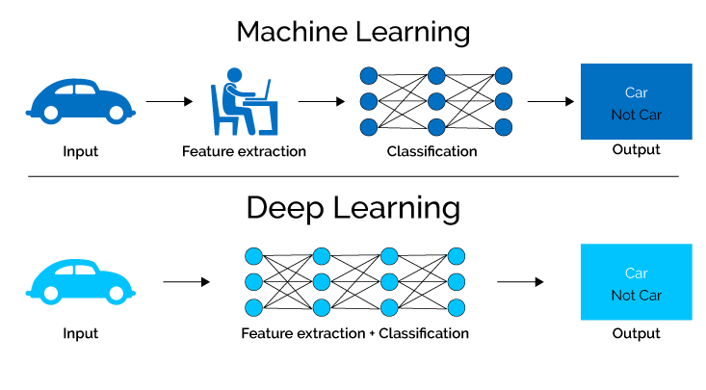
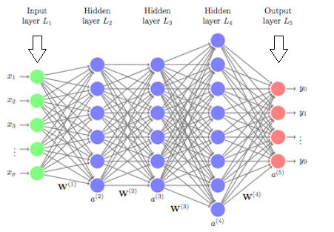
What is Deep Learning?
Deep learning is a subset of machine learning that focuses on artificial neural networks.
Convolutional Neural Networks (CNNs) are commonly used for defect classification in silicon wafers.
Deep learning offers a promising solution to address these challenges.

Slide 11
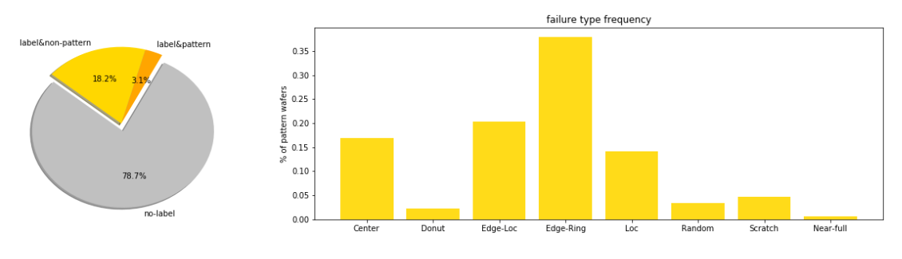
Research Problem and Questions
WM-811k dataset contains
811457
Wafer maps.

Slide 12

Research Problem and Questions
01
What are the appropriate methods for addressing class imbalance issues in an available dataset?
02
What are the appropriate methods for preparing data before the training and testing phases of a DL model?
03
How can mixed-type wafer defect patterns be generated? Can the DL model accurately classify multiple defects on a single wafer?
04
What are the methods for achieving high classification performance using deep learning-based classification models?
05
How can performance problems such as memory limits that may appear during the pre-processing of the data, training, and evaluation of the DL model be addressed?

Slide 13

Aims and Objectives of the Study
01
Produce a new, balanced wafer map defect dataset that includes various types of defects. Address the issues present in the current dataset, such as class imbalance, to ensure a more representative and balanced dataset for training and evaluation.
02
Publish the dataset to provide researchers with a representative and reliable resource for conducting in-depth studies and advancing the field of wafer map defect analysis.
03
Develop and deploy a customized DL model for accurate classification of wafer defects in an autonomous system that surpasses the performance of existing methods by achieving high precision and accuracy in categorizing different types of defects present on wafers.

Slide 14
Aims and Objectives of the Study
04
Improve the DL model's capability to accurately classify mixed types of defect patterns in a single wafer map by developing techniques to address the complexity and variability associated with mixed-type defects, thereby achieving precise classification outcomes.
05
Enhance the processing speed and efficiency of the DL classification model and overcome performance limitations by employing parallel computation techniques such as Compute Unified Device Architecture (CUDA).

Slide 15

Overview of Relevant Literature
01
IEEE Transactions on Semiconductor Manufacturing
Wafer defect pattern recognition and analysis based on convolutional neural network
93.25%
8
Accuracy
Single defect patterns
Proposed architecture with 13 layers
Notes:
In [35], they proposed using a 13-layer CNN to detect and classify eight known wafer map defects. The authors applied a median filter algorithm to remove noise from the wafer map images and resized them to 224x224 pixels. A Dropout method with a probability of 0.5 was employed to address the overfitting problem during training. The 'WM-811K' dataset which consists of 811,457 wafer map images including 172,950 labelled images and nine single defect patterns, served as the dataset for this study. The dataset was split into three subsets - training (60%), validation (15%), and testing (25%). The experiments conducted resulted in an impressive accuracy of 99.98% for detecting the presence of defect patterns on the wafer map. However, when it comes to classification, they achieved an average accuracy of 93.25%. The 'Donut' defect had a minimum average accuracy rate of 86%, while both the 'Edge-Ring' and 'Near-Full' defects achieved a maximum average accuracy rate of 100%.

Slide 16
Overview of Relevant Literature
02
CAAI Transactions on Intelligence Technology
Wafer map defect patterns classification based on a lightweight network and data augmentation
93.6% for single and
97.5% for mixed
38
Accuracy
Single and mixed
defect patterns
(WM-PeleeNet) with 9 layers
Notes:
In [36], the researchers proposed a lightweight classifier for wafer defect classification based on a proposed CNN architecture called ‘’WM-PeleeNet” with nine layers derived from the 'PeleeNet' CNN architecture to achieve a good balance between accuracy and efficiency in wafer defect classification. The datasets used were the 'WM-811K' and 'MixedWM38' datasets. The 'MixedWM38' dataset contains 38,000 wafer maps with nine single defect patterns and 29 mixed defect patterns. A data augmentation approach was used based on convolutional autoencoder, GAN-based, and image transformation methods to address the unbalanced distribution of defect images in the datasets. The input images were resized to 224x224 pixels to standardize the dimensions. The experiments showed that an average accuracy of 93.6% was achieved for single wafer defect patterns, with the minimum average accuracy for classifying the 'Local' defect being 92.2%, and the maximum average accuracy for classifying the 'Edge-ring' defect being 97.6%. Also, for mixed types of wafer defects using the 'MixedWM38' dataset, the experiments showed an average accuracy of 97.5%, with the minimum average accuracy for classifying the 'Center with Edge-Ring with Scratch' defect being 93.4%, and the maximum average accuracy for classifying the 'Donut with Edge-Ring with Scratch' defect being 100%.

Slide 17
Overview of Relevant Literature
03
Advances in Materials Science and Engineering
Classification of Silicon (Si) Wafer Material Defects in Semiconductor Choosers using
a Deep Learning ShuffleNet-v2-CNN Model
96.93%
8
Accuracy
Single defect patterns
(ShuffleNet-v2) with 7 layers
Notes:
in [37], a silicon wafer defect identification and classification model was proposed by researchers. This model consists of a pre-trained deep transfer learning model called ShuffleNet-v2 with seven layers using CNN architecture. It achieves an overall accuracy of 96.93%, precision of 95.40%, recall of 96.26%, and F1-score of 95.75% in classifying the defects. The training and testing phase utilized the 'WM-811K' wafer dataset, with data augmentation performed using a six-layer convolutional autoencoder CNN model. The total number of images used after data augmentation was 19,707, representing nine different patterns for wafer defects. However, because it is focused on being lightweight, the ShuffleNet-v2 may sacrifice some accuracy to achieve faster inference time and lower computational cost.

Slide 18
Overview of Relevant Literature
04
IEEE Transactions on Semiconductor Manufacturing
A Deep Convolutional Neural Network for Wafer Defect Identification on an Imbalanced Dataset
in Semiconductor Manufacturing Processes
96.2%
9
Accuracy
Single defect patterns
(CNN-WDI) with 16 layers
Notes:
in [38] the researchers proposed a deep learning-based CNN for automatic wafer defect identification with 16 layers. The model utilizes convolution layers to extract features and incorporates data augmentation and regularization techniques to enhance classification performance. Experimental results demonstrate that the model surpasses previous machine learning-based models, achieving an average classification accuracy of 96.2% on a wafer dataset 'WM-811K' consisting of nine wafer defect patterns. Methods such as image flipping, shifting, rotating, and zooming were applied during augmentation to address the class-imbalance problem in the dataset. However, no mention was made regarding how they addressed the overfitting problem associated with their CNN model's high accuracy.

Slide 19
Overview of Relevant Literature
05
IEEE Region 10 International Conference TENCON
Semiconductor wafer surface: Automatic defect classification with deep CNN
96.2%
12
Accuracy
Single defect patterns
(ResNet) with (VGG-16)
With dataset called “Dataset-TT”
Notes:
In, [39] the researchers present a system that utilizes DL techniques, specifically a ResNet101-based CNN model that was pre-trained on the ‘ImageNet’ dataset. For the sizing classification of two specific classes, the system employs a single-shot detection architecture based on VGG-16. The research utilized a dataset consisting of 8 defect classes, with 2 subclasses representing similar defects but varying in sizes. Data augmentation techniques were implemented to expand the dataset size. The obtained results showed a top-1 accuracy of 91.1% and a top-3 accuracy rate of 96.2%, with each class being correctly classified at least 69% of the time. The study acknowledges that the used dataset was relatively small and nonuniform. Future studies will explore employing advanced CNNs on larger datasets.

Slide 20
Overview of Relevant Literature
06
Machines (MDPI)
Improved Wafer Map Inspection Using Attention Mechanism and Cosine Normalization
95.46%
8
Accuracy
Single defect patterns
(ResNet-18)
Notes:
In [29], researchers propose a DL method that leverages the attention mechanism and cosine normalization to learn robust knowledge from imbalanced datasets. They introduce an improved convolutional attention module called CBAM to enhance the representation capabilities of the CNN model. They use the ResNet-18 CNN model with an improved convolutional block attention module (CBAM). The proposed method achieves an average accuracy of 95.46% on the imbalanced ‘WM-811K’ dataset with nine wafer defect patterns. The researchers propose the use of a cosine normalization algorithm as a replacement for the fully connected layer to address quantity distribution imbalance. The fine-tuning of the classifier was achieved by minimal iterative training which decreased the quantitative distribution sensitivity. Resolving the issue of imbalanced datasets may facilitate the implementation of the algorithm in actual manufacturing.

Slide 21
Overview of Relevant Literature
07
IEEE Access
Wafer Defect Localization and Classification Using Deep Learning Techniques
95.7%
9
Accuracy
Single defect patterns
(YOLO) version 3, 3-tiny and 4
Notes:
In [40], researchers focus on using DL approaches for automated wafer defect detection in semiconductor manufacturing. This study emphasizes the importance of defect localization by evaluating the performance of ‘YOLOv3’ and ‘YOLOv4’ object detection models in accurately locating and classifying wafer defects. The dataset ‘WM-811K’ was used with nine wafer defect patterns and input wafer images were resized to 416x416 dimensions. The results show that these models achieve over 95.7% classification accuracy in real-time. Other architectures like ‘ResNet50’ and ‘DenseNet121’ were also evaluated for defect classification but lacked localization abilities. The study highlights the significance of defect detection for quality management and yield improvement in semiconductor manufacturing. It discusses the effectiveness of ‘YOLOv4’ in defect localization and classification, with an average F-score of 0.92. The challenges in training DL models for wafer defect detection and the trade-off between underfitting and overfitting are also addressed in their study.

Slide 22
Overview of Relevant Literature
08
IEEE Transactions on Computer-Aided Design of Integrated Circuits and Systems
Semantic Segmentation Based Wafer Map Mixed-Type Defect Pattern Recognition
95.8%
38
Accuracy
Single and mixed
defect patterns
(U-Net)
Notes:
in [41] the researchers proposed a new framework for segmenting different defect patterns on wafer maps using a semantic segmentation approach, particularly when multiple defect types are mixed on the same wafer. They used ‘U-NET’ CNN architecture which consists of an encoder path that captures the contextual information and a decoder path that recovers the spatial information. The proposed method works well on single and known/unknown mixed types of defects. The authors extract defects from the single-defect wafer map of the ‘MixedWM38’ dataset to generate single-defect pixel-level labels. They then generate a mixed defect pattern dataset suitable for semantic segmentation using single-defect wafer maps and labels. The proposed method achieves an average accuracy of over 97% on the test set of their synthetic dataset and 95.8% on the ‘MixedWM38’ dataset when using the trained model for testing. This study addresses the challenge of identifying and distinguishing complex defect patterns that arise when different defect types coexist on the same wafer. This can be a difficult task due to the complexity and variability of mixed-type defects.

Slide 23
Gaps In the Literature
multiple defect types
complex tasks for data augmentation
create a reliable classification model
creation of standardized datasets covering a wide range of defect types

Slide 24
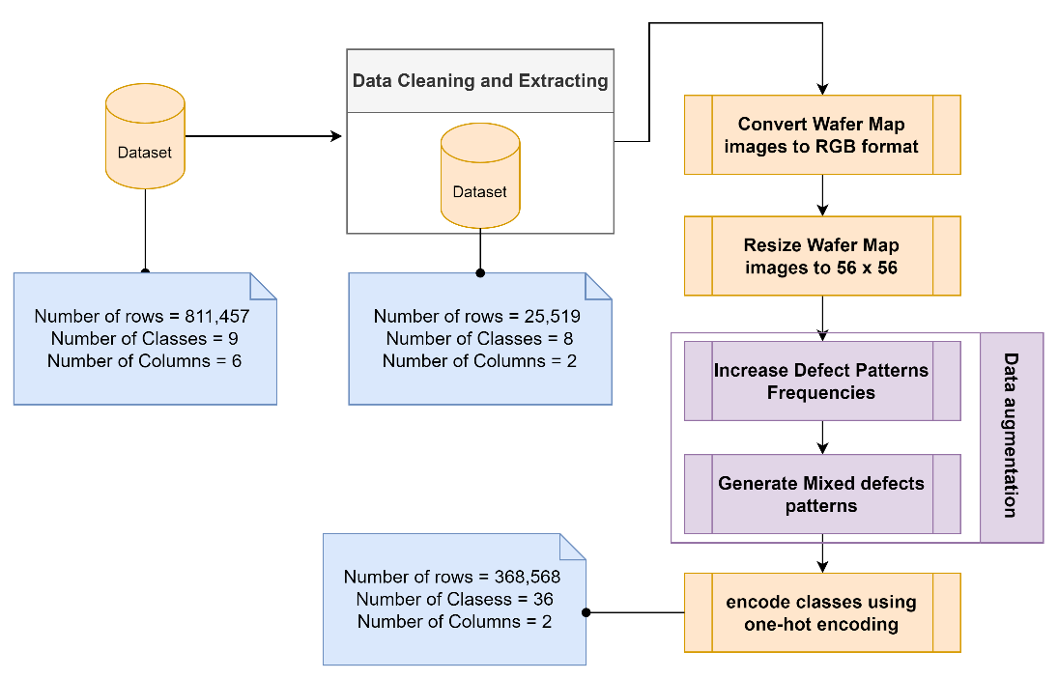
Data Pre-processing

Slide 25
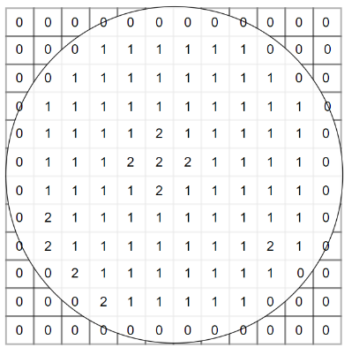
Data Pre-processing
0
Die Area (background or non-manufacturing region)
1
Die Pass Test Successfully (no defects)
2
Die Contain Defect (defective region)

Slide 26

Data Pre-processing
0
0
1
127
2
255

Slide 27
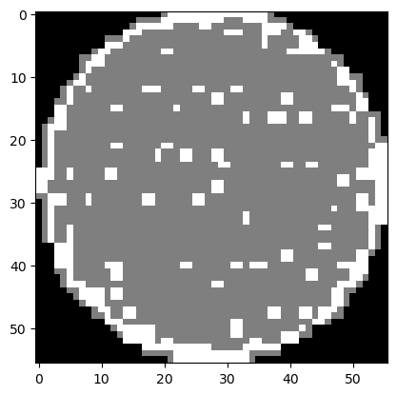
Data Pre-processing
56 x 56

Slide 28
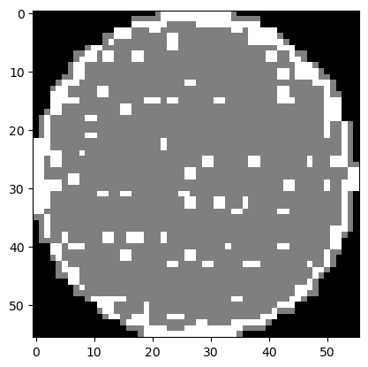
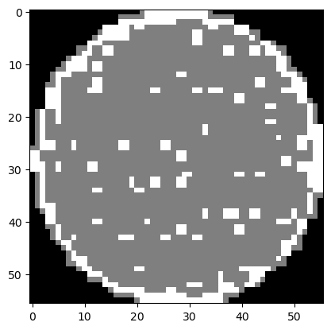
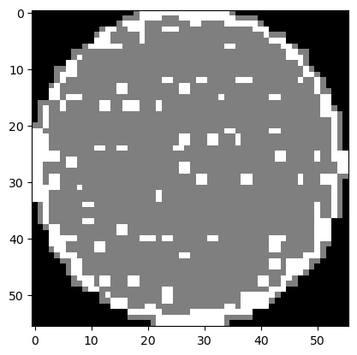
Data Augmentation Techniques
Image Random Rotation
Image Random Horizontal and Vertical Flip

Slide 29
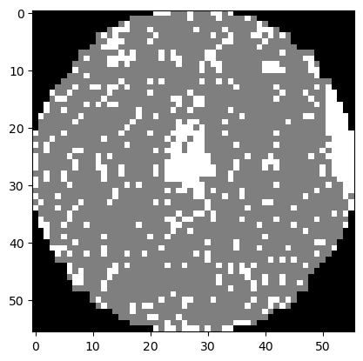
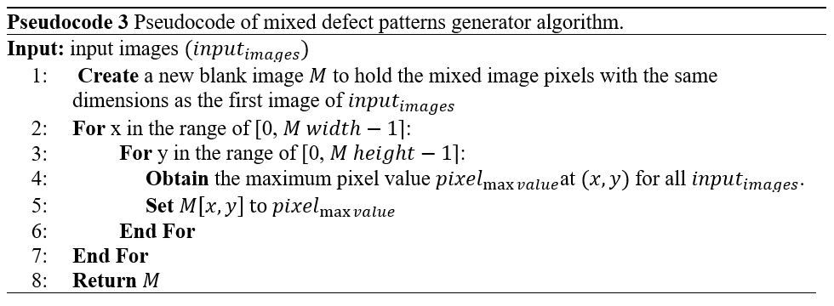
Data Augmentation Techniques
Center
Mixed Defect Patterns Generator
Edge-Loc
Center with Edge-Loc

Slide 30
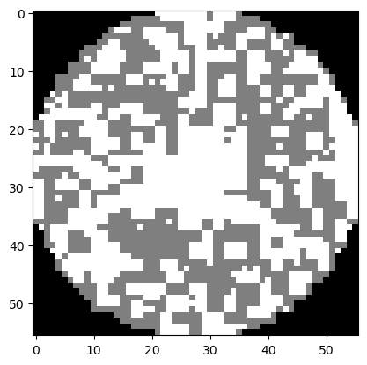
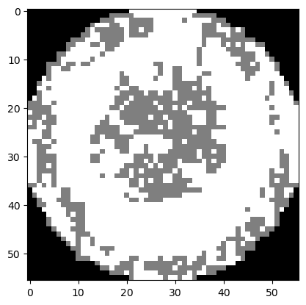
Data Augmentation Techniques
8
Single defect patterns
28
Mixed defect patterns

Slide 31
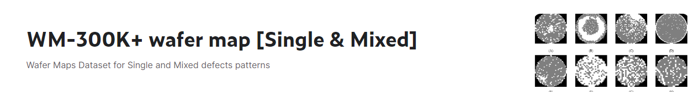

New Balanced Dataset
https://www.kaggle.com/datasets/husseinsalahyounis/wm-400k-wafer-map-single-and-mixed

Slide 32
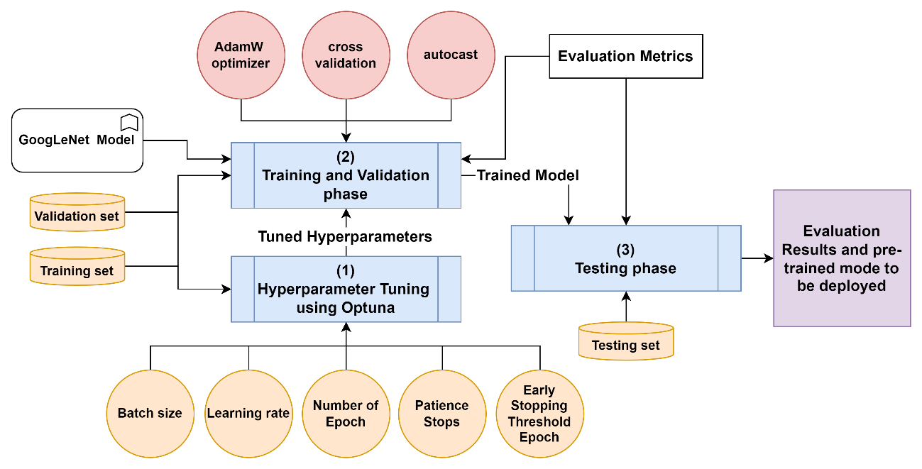
The Proposed Methodology

Slide 33
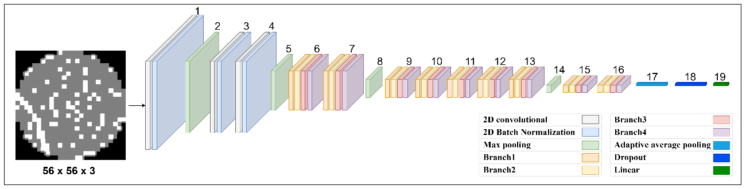

GoogLeNet Model
Notes:
GoogLeNet, developed by Google researchers in 2015, is a deep convolutional neural network architecture specifically designed for image classification [66]. With its original complex structure comprising 22 layers and 9 inception modules, GoogLeNet utilizes multiple convolutional layers of varying filter sizes and pooling operations within these modules. This enables the effective extraction of features at different scales, making it highly effective for image classification tasks.

Slide 34
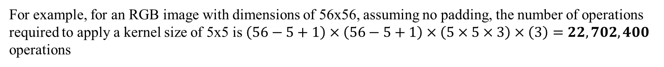
Why GoogLeNet Model?
For example, for an RGB image with dimensions of 56x56, assuming no padding, the number of operations required to apply a kernel size of 5x5 is $\left(56−5+1\right)×\left(56−5+1\right)×\left(5×5×3\right)×\left(3\right)=22,702,400$ operations
But if a kernel size of 1x1 is applied, the total number of operations for that filter is $\left(56×56\right)×\left(3×16\right)=2,985,984$. After applying the output of 1x1 kernel to 5x5 kernel, the total number of operations is $2,985,984+\left(\left(52x52\right)x \left(16 x 5 x 5\right)\right)=13,722,624.$There is a large amount of reduction in computation
Notes:
GoogLeNet, developed by Google researchers in 2015, is a deep convolutional neural network architecture specifically designed for image classification [66]. With its original complex structure comprising 22 layers and 9 inception modules, GoogLeNet utilizes multiple convolutional layers of varying filter sizes and pooling operations within these modules. This enables the effective extraction of features at different scales, making it highly effective for image classification tasks.

Slide 35
Configurations
6
GradScaler
36
KFold
scaler
classes
CrossEntropyLoss
AdamW
criterion
optimizer
0.0008
100
512
LEARNING_RATE
NUM_EPOCH
BATCH_SIZE
Notes:
"GradScaler" is a term that typically refers to a technique used in deep learning frameworks like PyTorch or TensorFlow to scale gradients during training. It helps prevent underflow or overflow issues that can occur when working with very small or very large gradients. GradScaler is commonly used in mixed-precision training to improve training stability and efficiency.
"CrossEntropyLoss" is a commonly used loss function in machine learning and deep learning tasks, especially in classification problems. It is often used when the model is predicting multiple classes and the output is in the form of probabilities. The CrossEntropyLoss function calculates the loss between the predicted probabilities and the actual target labels, aiming to minimize this loss during the training process.
"AdamW" works by incorporating weight decay directly into the optimization algorithm, rather than adding it as a separate regularization term after the optimization step like traditional weight decay methods. This approach helps prevent the optimization process from being affected by the weight decay hyperparameter, leading to better generalization performance.
In AdamW, the weight decay is applied to both the weights and the gradients during the optimization process. By decoupling weight decay from the optimization steps, AdamW ensures that the optimization algorithm can update the weights without interference from the weight decay term. This can help prevent overfitting and improve the generalization performance of deep learning models trained using AdamW.
Weight decay, also known as L2 regularization, is a common technique used in machine learning and deep learning to prevent overfitting. It involves adding a regularization term to the loss function during training that penalizes large weights in the model.
The weight decay term is calculated by multiplying the square of the weights by a regularization parameter λ, and then adding this term to the original loss function. This additional term encourages the model to learn simpler patterns by penalizing large weight values, which helps prevent the model from fitting noise in the training data and improves its generalization performance on unseen data.
By applying weight decay during training, the model is encouraged to find a balance between fitting the training data well and avoiding overly complex solutions. This regularization technique is a key component in preventing overfitting and improving the robustness of machine learning models.
Adam includes weight decay as a separate L2 regularization term added to the loss function after the optimization step.
AdamW incorporates weight decay directly into the optimization algorithm by decoupling it from the optimization steps. This helps prevent the optimization process from being affected by the weight decay hyperparameter, leading to potentially better generalization performance.

Slide 36
Dataset Splitting
Testing
20%
56%
Validation
24%
Training
Notes:
Total
368,568
Training set
206,397
Validation set
88,457
Testing set
73,714

Slide 37
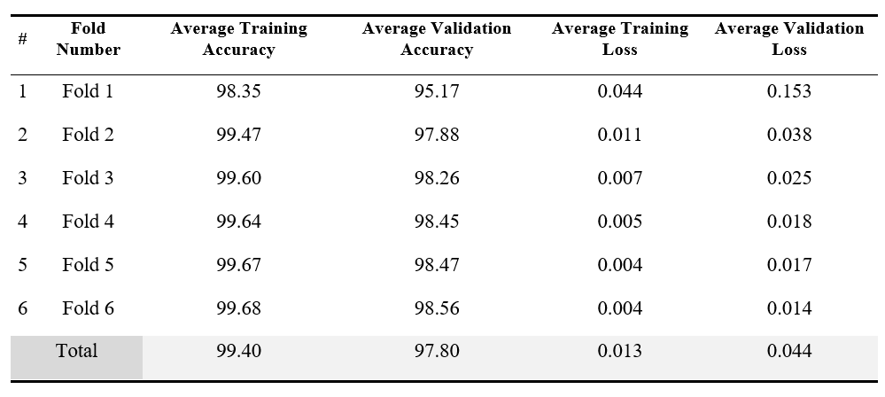
Findings and Discussions

Slide 38
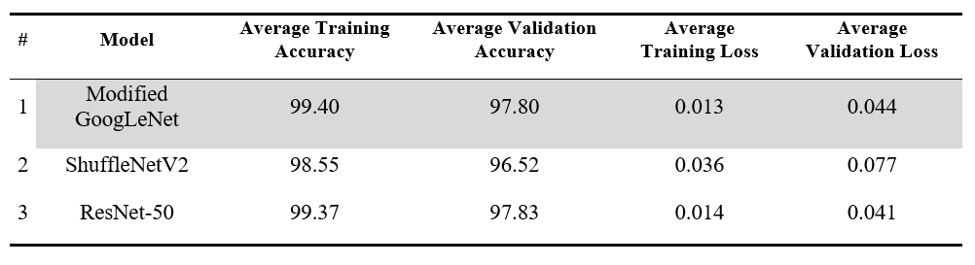
Findings and Discussions

Slide 39
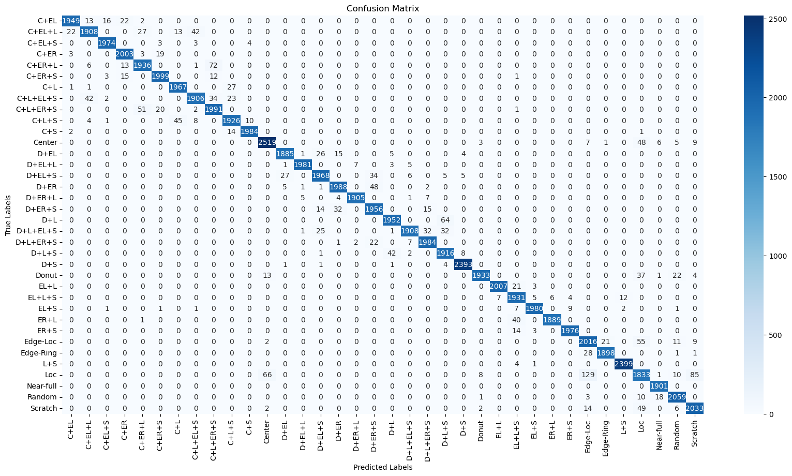
Findings and Discussions
Notes:
These classes demonstrate high numbers of true positives (TP) and true negatives (TN), indicating that the model accurately classifies instances belonging to these classes
further improvements may be needed to enhance its accuracy in correctly classifying instances for classes like "Edge-Loc" and "Loc."

Slide 40
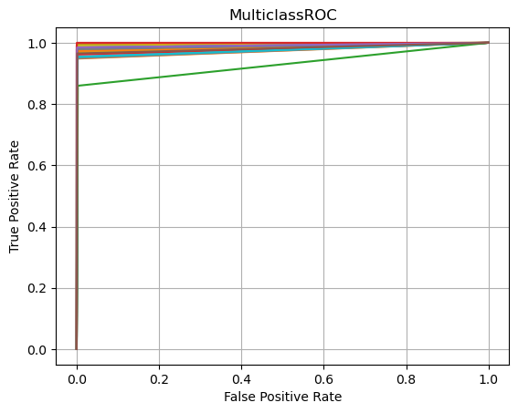
Findings and Discussions
Notes:
, the ROC curve for all classes is closer to the top-left corner of the plot which indicates that the model can accurately classify positive cases while minimizing false positives. the majority of the classes exhibit a high true positive rate, with many surpassing 0.98 and a low false positive rate (3.9045e-04). This indicates that the model is effective at correctly identifying positive cases while minimizing false positives and performing effectively and accurately in distinguishing between these classes. Nevertheless, the "Loc" class have a lower true positive rate of approximately 0.8598, suggesting that there may be challenges for the algorithm to differentiate them accurately, potentially necessitating further fine-tunning or optimization efforts.

Slide 41
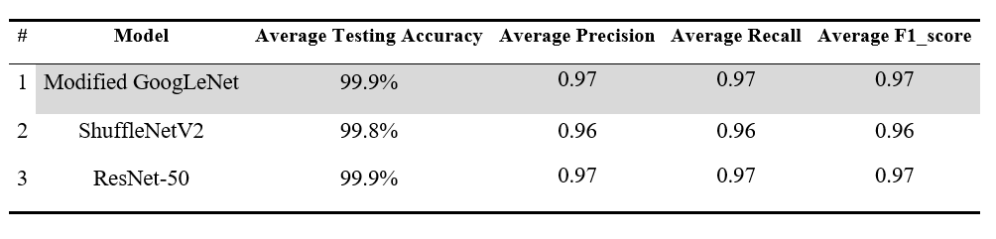
Findings and Discussions
Notes:
The algorithm demonstrates a good balance between precision and recall, indicating overall robust performance.
These high values for accuracy, precision, recall, and F1 score suggest that the classification algorithm is effective, and accurate in identifying and classifying instances across all classes.

Slide 42
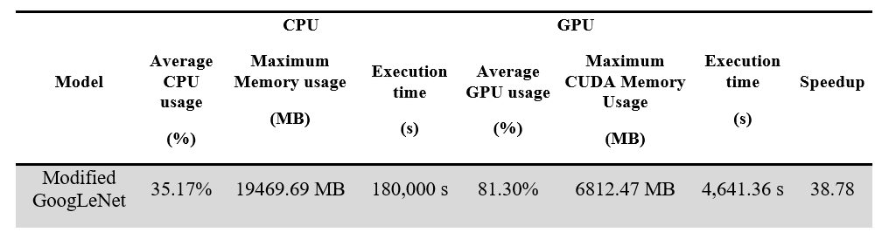
Addressing Memory Limit issues during Experiments

Slide 43
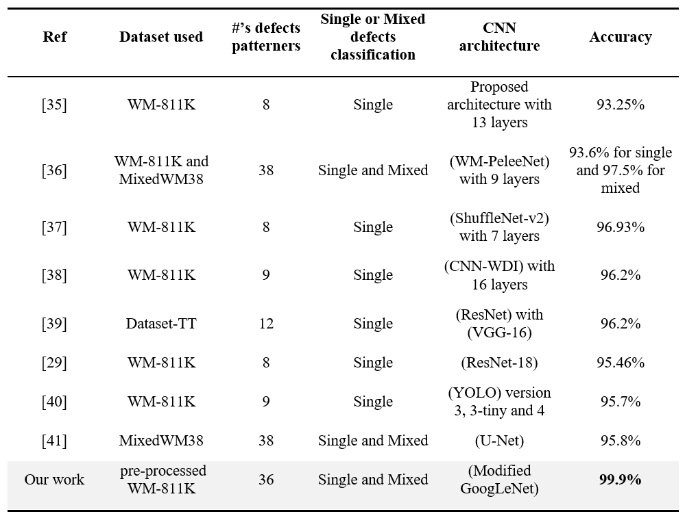
comprehensive overview of the performance of different CNN models in defect classification

Slide 44
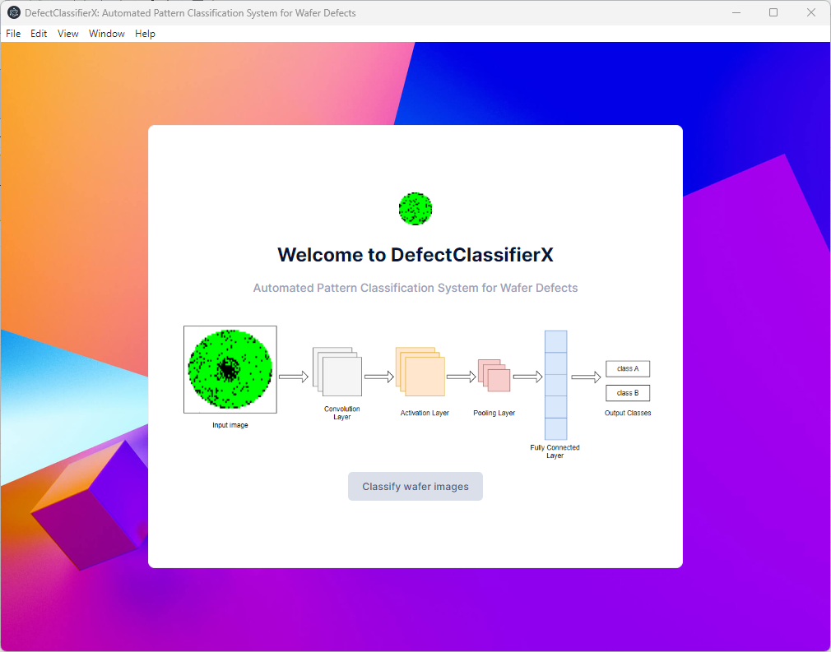
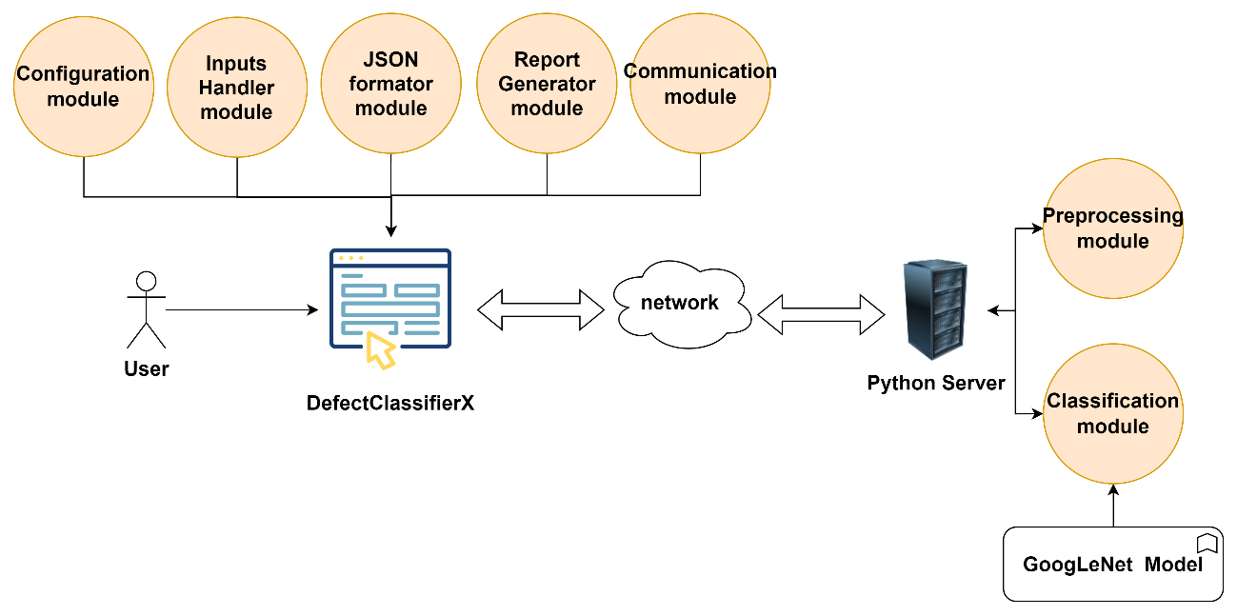
DefectClassifierX application

Slide 45

Research Contributions
01
Proposed CNN Model Based on GoogLeNet
02
Proposed the DefectClassifierX application
03
Classification of Single and Mixed Wafer Defect Patterns
04
Generalization to New Defect Types
05
Achievement of High Accuracy
06
Publication of WM-300K+ Wafer Map Dataset
07
Utilization of CUDA for Enhanced Training and Testing Speed

Slide 46

Limitations
01
Dependency on Dataset Quality
02
Computational Resource Requirements
03
Data Augmentation Limitations
04
Lack of Evaluation on Real Wafer Map Images

Slide 47
Conclusion
01
CNN model based on the GoogLeNet architecture
02
Average accuracy of 99.9%
03
Automated pattern classification system for wafer defects called "DefectClassifierX"
04
"WM-300K+ wafer map [Single & Mixed]"
05
CUDA for enhanced training and testing speed
06
Surpasses existing benchmarks and achieves state-of-the-art results in wafer defect pattern classification

Slide 48
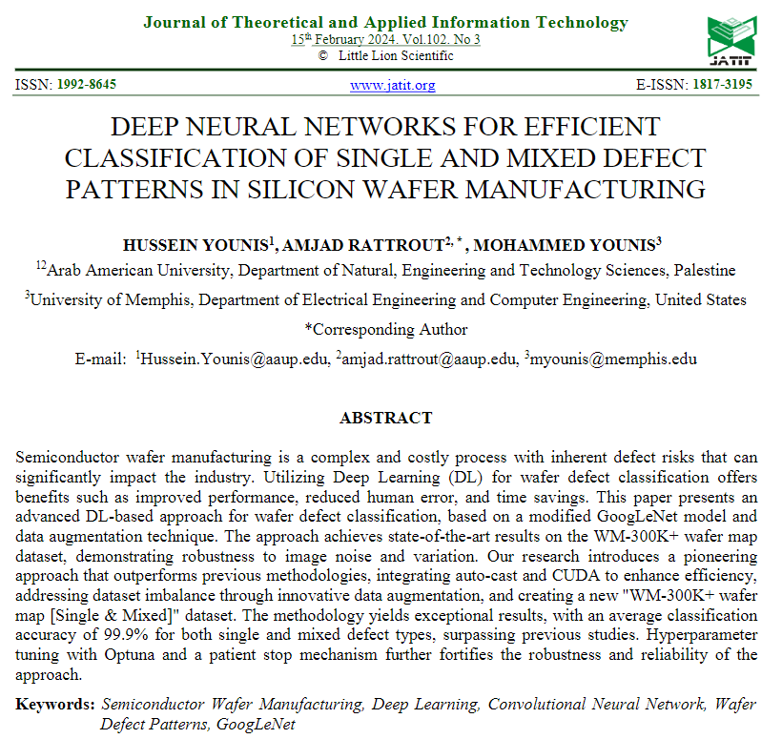

Publication
2024

Slide 49
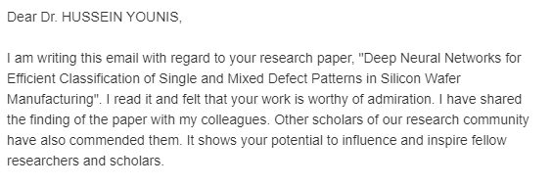
Feedback
Dr. Tiana G Twigg
Editor at Global Journals
United States of America

Slide 50
Other Publications
2024
International Journal of Advanced Computer Science and Applications
Enhancing Particle Swarm Optimization Performance through CUDA and Tree Reduction Algorithm
With DR. MUJAHED ELEYAT
2024
Journal of Theoretical and Applied Information Technology
RGB Image Encryption Algorithm Using 6D Hyperchaotic System And Fibonacci Q-matrix
With DR. MUJAHED ELEYAT

Slide 51
Other Publications
2023
Chapter In the book: New Technologies, Artificial Intelligence and Smart Data
Intelligent Multi-agent Distributed System for Improving and Secure Travel Procedures:
Al-Karama-King Hussein Bridge Study Case
With DR. Amjad Rattrout
2023
Conference: INTIS 2023
Intelligent Multi-agent Distributed System for Improving and Secure Travel Procedures:
Al-Karama-King Hussein Bridge Study Case
With DR. Amjad Rattrout

Slide 52

Thank You All!

